Slide 1



WELCOME TO THE RISKNZ LUNCHTIME SEMINAR SERIES 2018
RiskNZ gratefully acknowledges the support of our sponsors:
We also thank our hosts for this event:
KPMG (Wellington), Navigatus (Auckland), Christchurch City Council (Christchurch) and Powerco (New Plymouth)

Slide 2
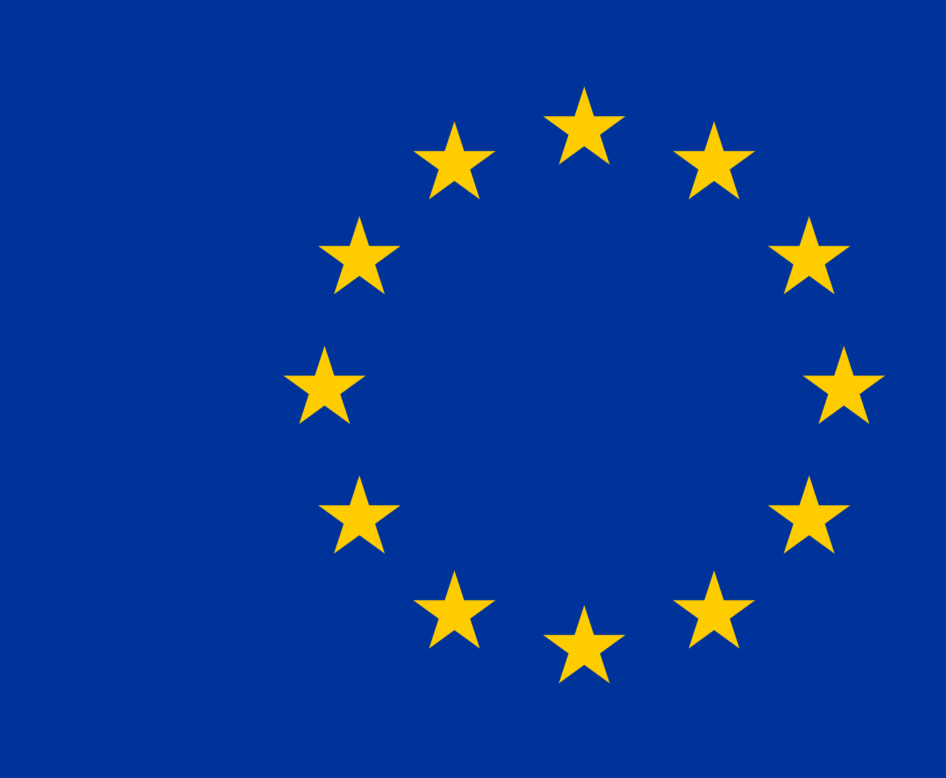

The GDPR in New Zealand? Easy as!
Date
An New Zealand viewpoint of the General Data Protection Regulation

Slide 3
Agenda
Why should I care?
Oh cr#*p – please tell me more.
What should I do to make it go away?

Slide 4

I General Provisions
II Privacy Principles
III Rights of the Data Subject
IV Controller and Processor
V Transfer of personal data to int. orgs.
General
Data
Protection
Regulation
VIII Remedies, Liabilities and Penalties
VI – VII Supervisory Authorities and Cooperation
IX – XI Additional Provisions
Notes:
Outline the structure of the GDPR
Structured as a set of recitals and articles.
Chapter I General Provisions
Chapter II Privacy Principles
Chapter III Rights of the Data Subject
Chapter IV Controller and Processor
Chapter V Transfer of personal data to third countries or international organisations
Chapter VI – VII Supervisory Authorities and Cooperation
Chapter VIII Remedies, Liabilities and Penalties
Chapters IX – XI Additional provisions (85 – 99)

Slide 5
‘the offering of goods or services… to data subjects.’
Article 3.2.a (Territorial Scope)
Notes:
The GDPR scope is broad – and goes beyond the European Union (the Union)
The default scope applies to processing activities in the Union, but can also apply to New Zealand-based businesses offering goods or services in to individuals in the Union.
2. The Regulation applies to the processing of personal data of data subjects who are in the Union by a controller or processor not established in the Union, where the processing activities are related to:
(a) the offering of goods or services, irrespective of whether a payment of the data subject is required, to such data subjects in the Union; or
(b) the monitoring of their behaviour as far as their behaviour takes place within the Union.
Key definitions:
Data Subject – A natural living person who is in the Union; whatever their nationality or place of residence (recital 14).
Offering Goods and Services - (offers the option to view in German and French, or currency).
Explore a couple of hypothetical examples.

Slide 6
Personal data is information that relates to an identified or identifiable individual
Indirectly identifiable
Car Registration
Directly identifiable
Name
Sensitive
Special Category (Race, ethnic origin, policies, religion, genetics, biometric, health, sexual orientation)
Criminal Offence (allegations, proceedings, convictions)
Identification number
Bank statement
Electricity ICP number
Combination of criteria (e.g. age, occupation, location)
Online identifier (e.g. MAC address, account handle, cookie).
Telephone bill
Notes:
Personal Data – any data that relates to a Data Subject, that can be used to directly or indirectly identify them. (e.g. car registration number, insurance number, CCTV footage, combination of criteria [age, occupation, post code]).
Directly identifiable:
#1
Mr Michael Price
Information Avenue
Wellington
6011
#2
michael.price@axenic.co.nz
Learn that Michael works at Axenic.
Indirectly identifiable
Key point is that it needs to be combined with information that then allows the identification of an individual
#3
ICP on its own its not much – but when associated with the electricity account it relates to, you can identify the individual.
#4
Photo about an elderly man who lives at 15 Information Avenue, and drives a red Toyota.
#5
Wi-Fi analytics – tracking customers in stores. The MAC address

Slide 7
The GDPR Principles
Lawfulness, fairness and transparency
Purpose limitation
Data minimisation
Accuracy
Storage limitation
Integrity and confidentiality
Accountability
Notes:
The GDPR sets seven principles in (Article 5), that need to be included with your approach to handling personal data
Similar to the New Zealand Privacy Principles.
Lawfulness, fairness and transparency
Lawfulness – a number of lawful bases (to discuss later
Fairness – personal data is handled in a way that could be reasonably expected, and explain any unexpected processing is justified.
Transparency – Open, honest and inform the individuals concerns using plain language in a manner that is easy to understand.
Accurate
Take steps to ensure that the data you handle is correct, and will be integrity assured through its use.
The data may need to be updated to ensure its currency.
You may need to consider any challenges to the accuracy of data – and handling rectification requests. Record any challenges and decisions.
Accountability
Demonstrate compliance with the GDPR.
Implement organisational and technical measures.
Other things to consider;
Adopting and implementing data protection (privacy) policies
Privacy by design and default
Ensuring written contracts are in place with controllers, processors and sub processors.
Documenting data processing activities
Recording and reporting personal data breaches (potential or confirmed).
Data protection impact assessments – high risk to individual interests
Appointing a Data Protection Officer (DPO)
Adhering to a code of conduct or similar certification scheme.

Slide 8
Lawful bases for processing
Consent
Contract
Legitimate Interests
Legal Obligation
Public Task
Vital Interests
Notes:
What are the lawful bases for processing?
The lawful bases for processing are set out in Article 6 of the GDPR. At least one of these must apply whenever you process personal data.
Most NZ-based organisations would expect to be one of the following four:
(a) Consent: the individual has given clear consent for you to process their personal data for a specific purpose.
(b) Contract: the processing is necessary for a contract you have with the individual, or because they have asked you to take specific steps before entering into a contract.
(c) Legal obligation: the processing is necessary for you to comply with the law (not including contractual obligations).
(f) Legitimate interests: the processing is necessary for your legitimate interests or the legitimate interests of a third party unless there is a good reason to protect the individual’s personal data which overrides those legitimate interests. (This cannot apply if you are a public authority processing data to perform your official tasks.)
Additional to this are more specific bases.
(d) Vital interests: the processing is necessary to protect someone’s life.
(e) Public task: the processing is necessary for you to perform a task in the public interest or for your official functions, and the task or function has a clear basis in law.
https://ico.org.uk/for-organisations/guide-to-the-general-data-protection-regulation-gdpr/lawful-basis-for-processing/

Slide 9
The GDPR Data Subject Rights
Right to be informed
Right of access
Right to rectification
Right to erasure
Right to restrict processing
Right to data portability
Rights in relation to automated decision making and profiling
Notes:
Right to erasure:
The right is not absolute and only applies in certain circumstances (typically relates to lawful basis, consent, legitimate interest).
Emphasis applies if the personal data relates to children.
Right in relation to automated decision making
Two aspects; automated individual decision-making and profiling.
Can only be carried out under lawful basis (contract, legal).
Must provide a means to challenge decision and request human intervention.

Slide 10


Controllers and Processors
Data Controller
Data Processor
A controller determines the purposes and means for processing personal data
A processor is responsible for processing personal data on behalf of a controller.
Notes:
The GDPR distinguishes between two key entities; the Data Controller and the Data Processor.
Discuss the relation and some examples of these in the real world (e.g. Xero and AWS).

Slide 11

Data Controller
Adopt data protection policies
Formalise contracts
Data Processor
Ensure contract with controller
Sub-processor
Similar to Data Processor
Document processing activities
Implement security measures
Managing personal data breaches
DPIA
Appoint a DPO
Record processing activity
Implement security measures
Notify controller of breaches
Adhere to certification scheme
Notes:
As a Data Processor, you are directly responsible for a number of responsibilities under the GDPR.
Do not use a sub-processor without prior written authorisation of the Data Controller (Article 28.2).
Only handle personal data on the written instructions of the Data Controller (Article 29).
Keep records of data processing activities (Article 30.2).
Co-operate with supervisory authorities (e.g. the Information Commission Office) (Article 31).
Ensure the security of data processing activities (Article 32).
Notify the Data Controller of any personal data breaches (Article 33).
(If required) Appoint a representative within the European Union (Article 27).
(If required) Assign a Data Protection Officer (Article 37).

Slide 12



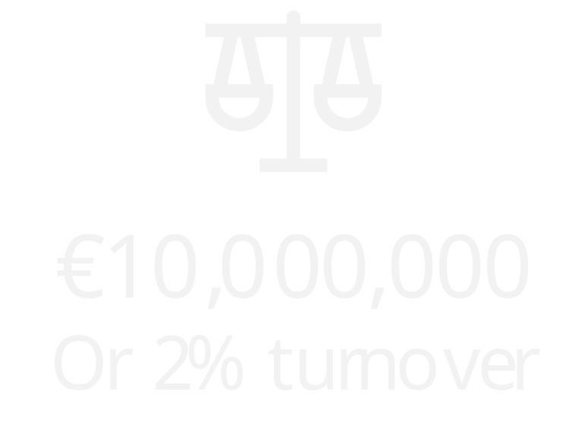
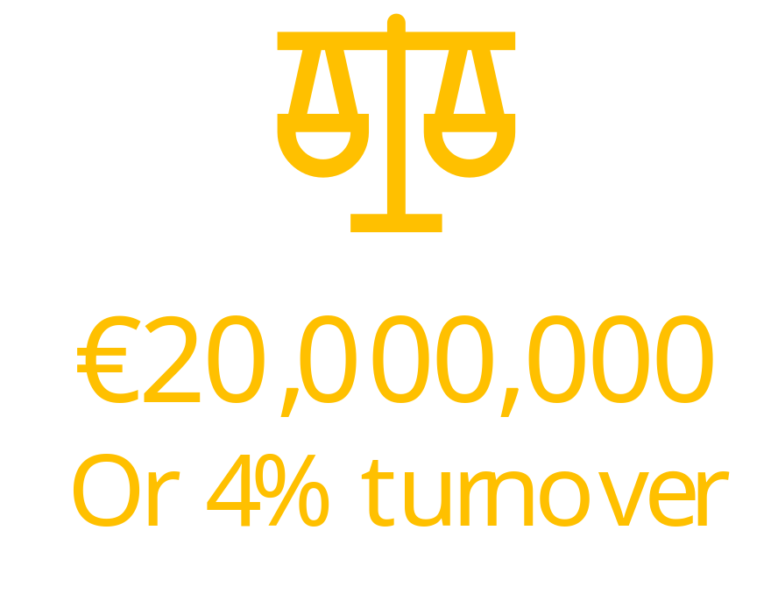

The carrot
or the stick?
Notes:
If you fail to meet these obligations, you may be subject to an administrative fine (Article 83), penalty (Article 84), or compensation claim (Article 82).
Mention Facebook – following the Cambridge Analytica fines. Under the previous Data Protection Act, they faced a EUR$500,000.00 fine (maximum at the time).

Slide 13
Summary
Overview the GDPR and key chapters
Key definitions and buzzwords
Principles and Data Subject rights
Differences between a Data Controller and Processor
Liabilities and penalties

Slide 14

Questions

Slide 15


Slide 16
Lunchtime Seminar Series 2018
The team at RiskNZ would like to thank you again for joining the Lunchtime Seminar. We hope you find the topic and presentation of interest and of use. Please send any feedback to execofficer@risknz.org.nz
RiskNZ gratefully acknowledges the support of our sponsors:
We also thank our hosts for this event:
KPMG (Wellington), Navigatus (Auckland), Christchurch City Council (Christchurch) and Powerco (New Plymouth)

