Slide 1



RiskNZ gratefully acknowledges the support of our sponsors
We also thank our hosts for this event:
Beca, Wel Networks, Christchurch City Council, KPMG and Powerco

Slide 2
The impact of disasters on inflation
Miles Parker*
RBNZ & Victoria University of Wellington
RiskNZ lunchtime seminar, 10 May 2016
* The views expressed here are those of the speaker and not necessarily those of the Reserve Bank of New Zealand.

Slide 3
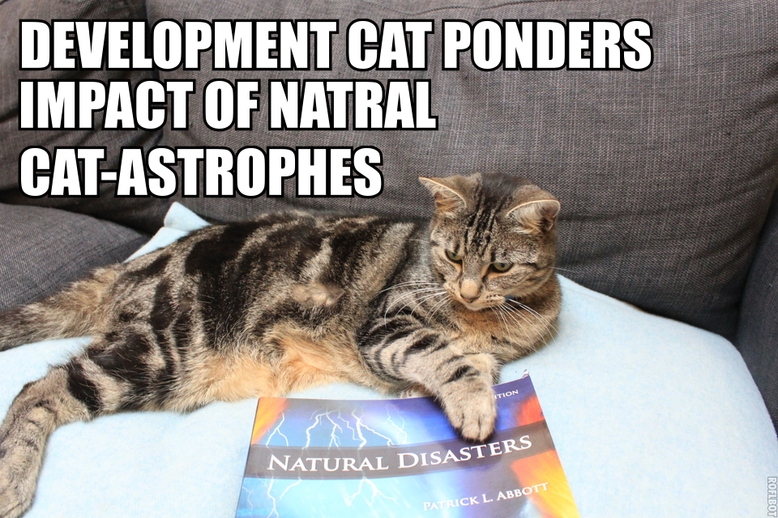

Slide 4
Overview
A brief introduction to (macro)economic effects of disasters
How prices might be affected
Method
Results

Slide 5
Overview of economics literature

Slide 6
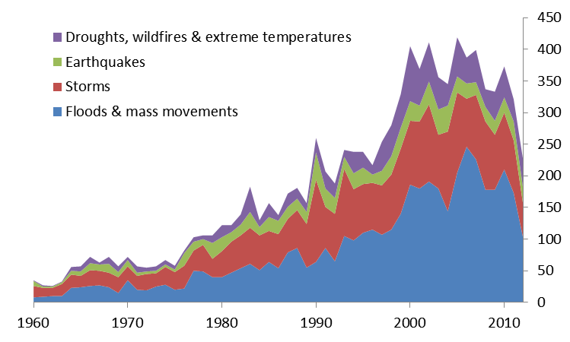
How frequent are disasters?
Very!
Source: EMDAT.

Slide 7
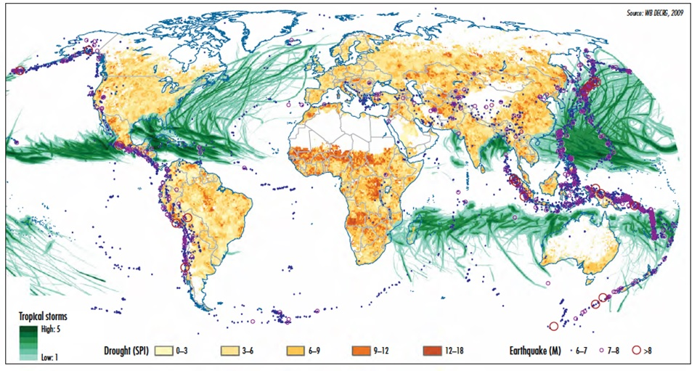
Disaster incidence

Slide 8
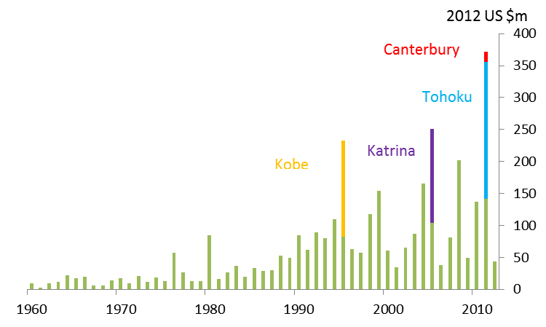
Increasing (measured) economic damage
Source: EMDAT, presenter’s calculations.

Slide 9
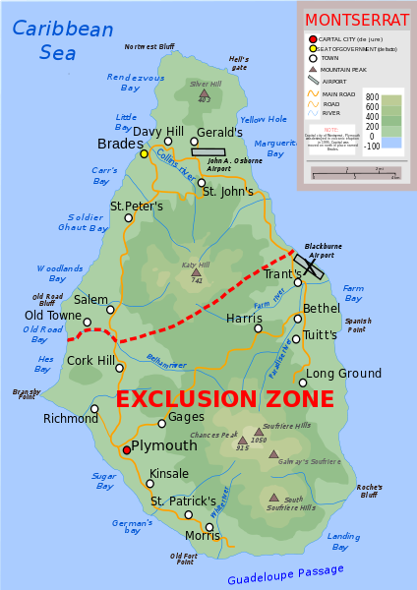
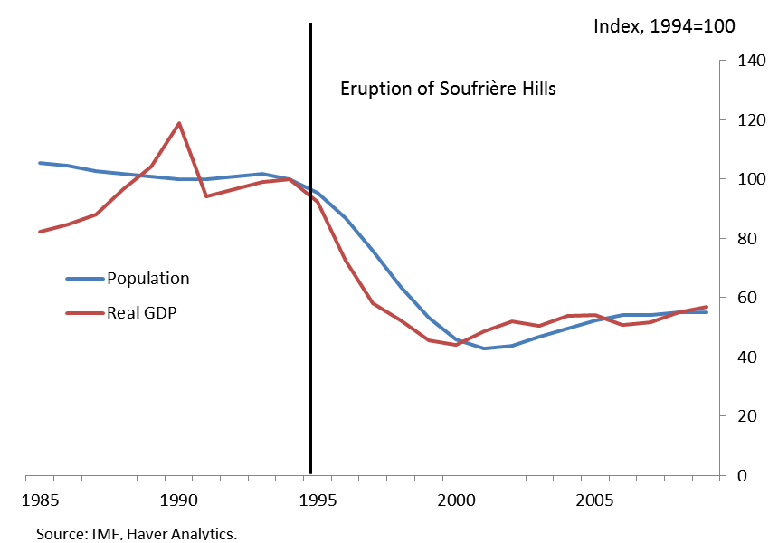
Big disasters: Montserrat

Slide 10
Why care about prices?
Guidance for monetary policy
Insurance costs of rebuild / cash settlement
Aid donors assessing value of gift
Fiscal costs of rebuild
Implications for exchange rate and capital account policies

Slide 11

Previous literature on disasters and prices

Slide 12
Insights from literature on GDP
Level of development and institutions matter (Noy, 2009)
Impacts differ by type of disaster (Radatz, 2009; Felbermayr & Groeshl, 2014)
Impacts differ by type of activity (Loayza et al., 2012; Fomby et al. 2013)

Slide 13
Effects of disasters
Short-run impact
Destruction of property, crops, infrastructure
Disruption of economic activity (direct and indirect)
Medium-term impact
Rebuild
Impact on wealth

Slide 14
Impact on prices
Shortages (buildings, food) increases prices
Surpluses (water) lowers prices
Disruption (lower demand) lowers prices
Reconstruction demand surge increases prices
Lower wealth, lower demand, lowers prices

Slide 15
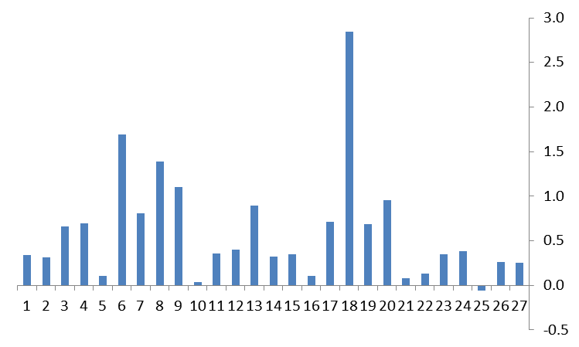
An example - Christchurch

Slide 16
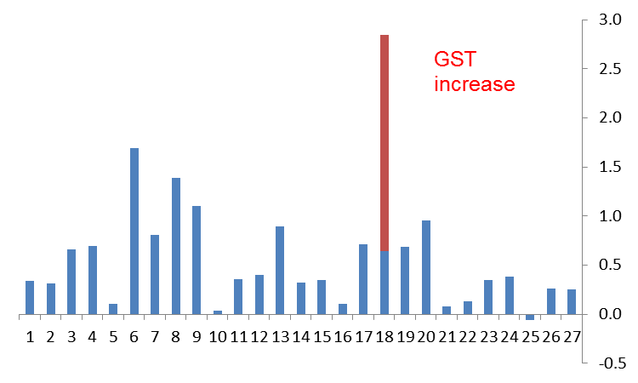
The initial impact on CPI

Slide 17
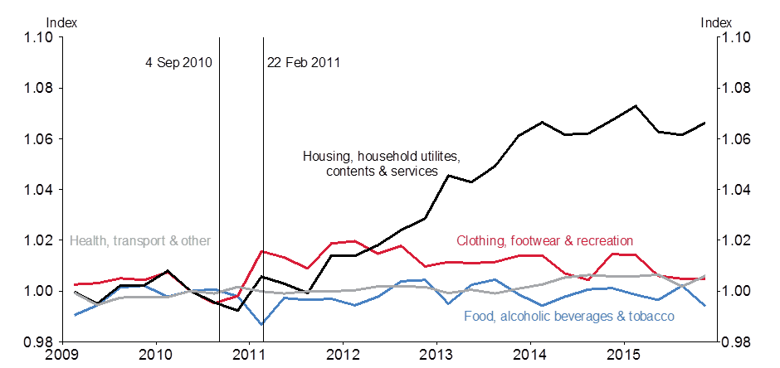
Consumer prices, Canterbury relative to rest of NZ

Slide 18
Data

Slide 19
Data - disasters
EMDAT database (CRED at Catholic University of Louvain) defines disasters as:
  10 or more people killed
  100 or more people affected
  A state of emergency declared
  A call for international assistance
Remove smallest disasters, resulting in 1349 disasters in 163 countries.

Slide 20
Disaster types
Earthquakes
Floods
Storms
Droughts
Other (wildfires, volcanoes, insect infestations, mass movements, extreme temperatures)

Slide 21
Data - CPI
Headline CPI for 223 countries and territories
Sub-indices for:
  food,
  housing,
  energy
  and the rest of the index (“CPIxFHE”)
Coverage by sub-index varies

Slide 22
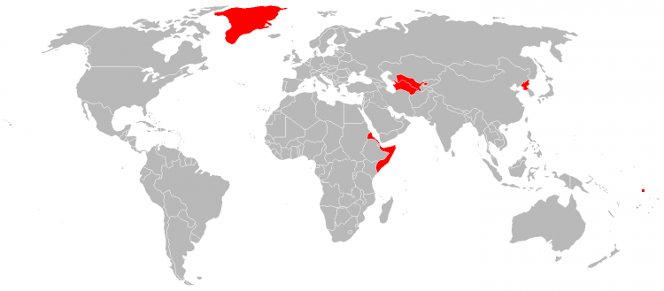
Data - CPI

Slide 23
Method & results

Slide 24
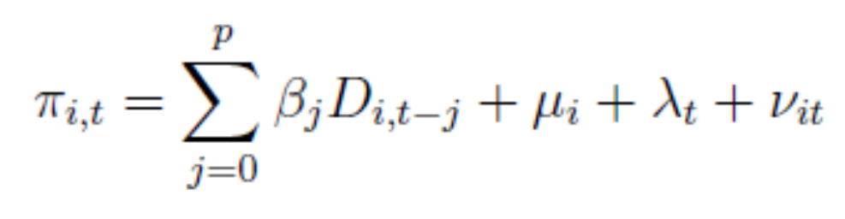
Method
Formally:
In other words:
The impact on quarterly inflation over time, taking into account differences in average country inflation rates and world inflation factors

Slide 25
Results
75th percentile
  Approx. Hurricane Earl on Antigua & Barbuda 2010
  Affected around 6 percent of population
  Damage around 1 percent of GDP
90th percentile
  Approx. Chile earthquake of 2010
  562 killed, 16 percent of population affected
  Damage around 17 percent of GDP

Slide 26
Earthquakes – 75th percentile
 | Headline | Food | Housing | Energy | CPIxFHE
Qtr 0 | 0.2 | 0.2 | 0.0 | -0.3 | -0.1
Qtr 1 | 0.0 | -0.1 | *0.2 | **0.8 | ***-0.2
Qtr 2-3 | 0.0 | -0.2 | -0.2 | -0.5 | ***-0.3
Year 1 | 0.3 | 0.0 | 0.0 | 0.0 | ***-0.6
Year 2 | 0.4 | 0.3 | 0.0 | 1.9 | ***-0.5
Year 3 | 0.2 | 0.4 | -0.3 | -0.7 | -0.4
Note: *,**,*** Significant at 5,1,and 0.1 percent respectively

Slide 27
Storms – 75th percentile
 | Headline | Food | Housing | Energy | CPIxFHE
Qtr 0 | 0.1 | *0.2 | -0.1 | -0.5 | 0.0
Qtr 1 | 0.1 | *0.2 | 0.0 | -0.3 | -0.1
Qtr 2-3 | -0.2 | ***-0.3 | *-0.3 | 0.0 | -0.1
Year 1 | 0.0 | 0.0 | -0.4 | -0.8 | -0.1
Year 2 | -0.1 | 0.0 | ***-0.6 | 0.1 | -0.1
Year 3 | -0.1 | 0.1 | *-0.4 | 0.2 | 0.2
Note: *,**,*** Significant at 5,1,and 0.1 percent respectively

Slide 28
Floods – 75th percentile
 | Headline | Food | Housing | Energy | CPIxFHE
Qtr 0 | *0.4 | 0.1 | -0.1 | -0.2 | -0.1
Qtr 1 | 0.2 | 0.1 | -0.1 | -0.3 | -0.2
Qtr 2-3 | 0.4 | -0.2 | 0.0 | -0.2 | 0.0
Year 1 | 0.9 | 0.1 | -0.2 | -0.8 | *-0.3
Year 2 | 1.7 | 0.0 | -0.3 | **1.2 | -0.1
Year 3 | 1.5 | 0.3 | -0.1 | -0.1 | 0.0
Note: *,**,*** Significant at 5,1,and 0.1 percent respectively

Slide 29
Droughts – 75th percentile
 | Headline | Food | Housing | Energy | CPIxFHE
Qtr 0 | *1.4 | 0.5 | -0.1 | 0.2 | 0.1
Qtr 1 | *1.3 | 0.4 | -0.3 | -0.2 | -0.2
Qtr 2-3 | 2.0 | -0.1 | **-0.7 | -0.6 | **-0.7
Year 1 | *4.6 | 0.9 | -1.1 | -0.6 | -0.7
Year 2 | 7.1 | 0.1 | -0.7 | -0.7 | -0.2
Year 3 | *5.2 | 1.7 | -0.4 | 1.2 | -0.1
Note: *,**,*** Significant at 5,1,and 0.1 percent respectively

Slide 30
Other observations
Effects more pronounced in developing countries (for a given magnitude of event)
In OECD countries, little significant impact on inflation (credible monetary policy?)
Large disasters have proportionately larger impact on inflation

Slide 31
Conclusions
Disasters have the potential for a large and sustained impact on prices
Impact depends on type of disasters, individual sub-indices, size of disaster and level of economic development

Slide 32
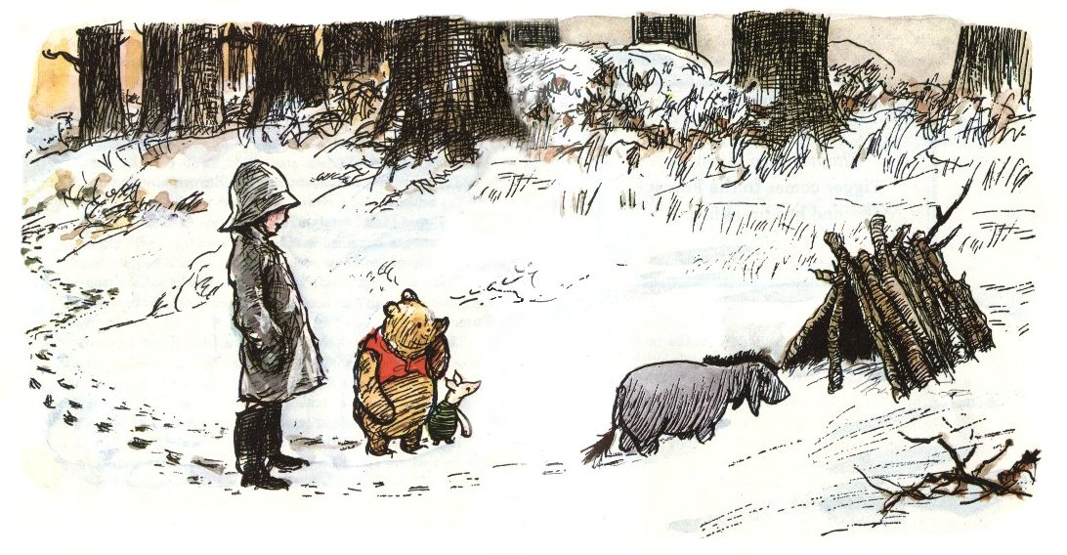
Some words of optimism
“It’s snowing still,” said Eeyore.
“So it is.”
“And freezing.”
“Is it?”
“Yes,” said Eeyore. “However,” he said, brightening up a little, “we haven’t had an earthquake lately.” A.A.Milne House on Pooh Corner
Illustration by E.H.Shepard

Slide 33
Sources
Disasters and inflation:
Parker, Miles (2016), ‘The impact of disasters on inflation’, RBNZ Discussion Paper No. 2016/06
http://www.rbnz.govt.nz/research-and-publications/discussion-papers
CPI data:
Parker, Miles (2016), ‘Global inflation: the role of food, housing and energy prices’, RBNZ Discussion Paper No. 2016/05.
http://www.rbnz.govt.nz/research-and-publications/discussion-papers
Canterbury earthquakes:
Wood, Amy, Noy, Ilan and Miles Parker (2016), ‘The Canterbury rebuild five years on from the Christchurch earthquake’ RBNZ Bulletin 79 (3).
http://www.rbnz.govt.nz/-/media/ReserveBank/Files/Publications/Bulletins/2016/2016feb79-3.pdf

Slide 34
SAVE THE DATES
8 JUNE – RISKNZ AGM
15 SEPTEMBER – RISKNZ DEVELOPMENT DAY - WELLINGTON

